Slide 1

Year 1 Welcome Meeting
2025- 2026

Slide 2
Meeting the Year 1 team
Miss Patel- Phase Leader
Miss Parvu
Johnson class
Miss Gaurh
Shackleton class
Mrs Norman
Cousteau class
Chain of communication
Class Teacher → Phase Leader → Senior Leadership

Slide 3

Attendance / Lateness
Attendance is key to making good progress, so it’s really important to ensure your child attends everyday.
It is important that your child is at school on time as core subjects take place in the mornings.
Timings to school day : 8.50am -3.30pm
Gates close at 9am

Slide 4

Meal selection
If your child is school dinners, please pre-order lunches at home before 9am.
Even if they are school dinners, please make sure that they bring a labelled water bottle with them.

Slide 5
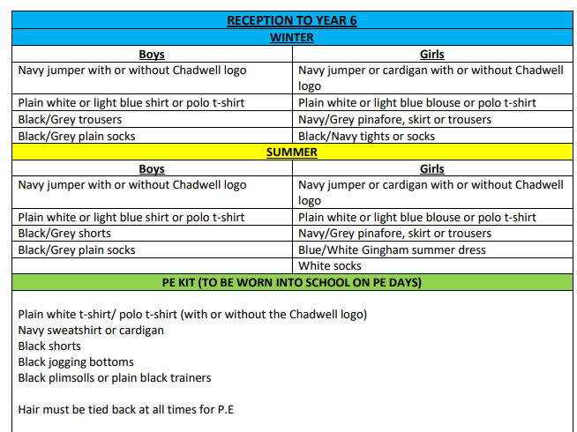
Uniform
This document can be found on our school website under the 'parents' tab.

Slide 6
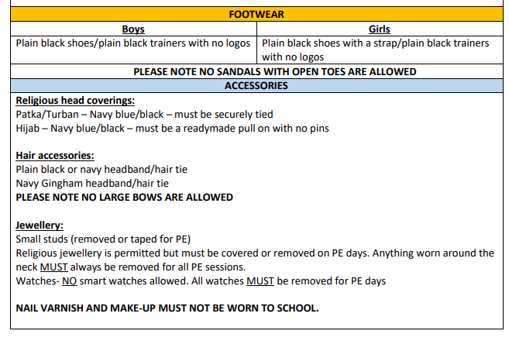
Uniform
This document can be found on our school website under the 'parents' tab.

Slide 7
P.E. Uniform
Black/Navy shorts
Plain white or blue T-shirt
Black plimsolls or trainers
Black or Navy track suit or jogging bottoms for outdoor games in cold weather
Pupils can also wear their school uniform jumper on top during colder weather

Slide 8

P.E. days
Please ensure that your child wears their P.E. kit to school, underneath their jumper.
Outdoor P.E. slots:
Johnson Class: Tuesday
Cousteau Class: Tuesday
Shackleton Class: Thursday

Slide 9
Differences between Reception and Year 1
The children’s day is more structured with a distinct separation between play and learning.
Children’s learning is categorized into clear subjects.
Children are expected to sit for longer periods.
Children have less choice in deciding how they learn.
No continuous provision for outdoor learning.

Slide 10
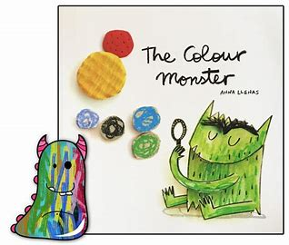







Writing
English lessons are based on a core text.
Writing is taught both through discrete English lessons and through other areas of the curriculum.
The texts we will be focusing on this year are:
The Colour Monster, The Story Machine, Meesha makes Friends, Katie in London, The Lion Inside, The Curious Case of the Missing Mammoth, Toys in Space, Goldilocks and Just the One Bear

Slide 11
Reading
We teach reading through:
Use of the Oxford Reading Tree scheme to teach Reading (de-coding, segmenting, blending and vocabulary) as well as reading skills (prediction, comprehension, features of books)
Free choice of books from class reading area
Free choice of books from school library
Guided Reading to teach specific types of reading skills
Reading and the teaching of books in English lessons – whole school
You could:
Visit your local library
Have story time before bed
Read regularly with your child

Slide 12
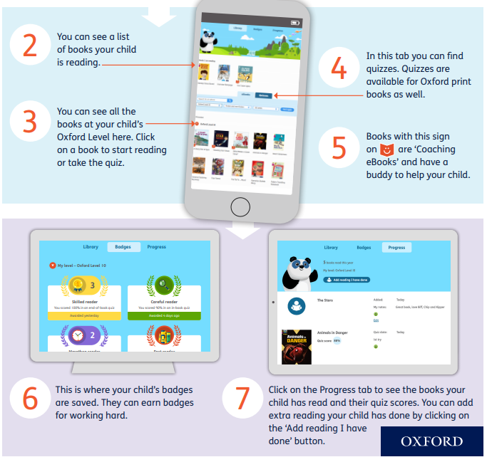

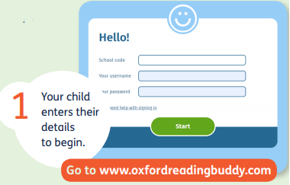
Reading – Oxford Reading Buddy
n1tts
Every child has a log on card.

Slide 13

Reading books
Children will change their books at least once a week.
Reading records will not be used.
Please read with your child as often as possible.
It is essential to talk through the book with your child and ask them questions to monitor their understanding and deepen their comprehension skills.

Slide 14
Phonics Screening- Year 1- Summer Term
Phonics screening
There will be a strong focus on Phonics and Reading throughout Year 1.
We will follow the Essential Letters and Sounds Scheme to provide a structured and systematic approach to teaching literacy.
The new National Curriculum emphasises the importance of children learning to read using a phonics-based approach. Children will learn the phonetic sounds to help them blend and read the words. Teaching them the right phonics skills will ensure they become successful readers and make them feel confident when taking the Phonics Screening Test at the end of Year 1.
There will be more information and workshops throughout the year.

Slide 15

Relationship and Health Education (RHE)
These lessons are compulsory, and you will not be able to pull your child out
As part of the National curriculum children will be learning about the scientific names of the body parts from Year 3 onwards.
In Year 1, children will be taught the term private parts in conjunction with the NSPCC PANTS RULE.
In Year 1, we will be learning about Relationship and Health Education in the summer term.

Slide 16


Maths – Maths Mastery
Mathematics Mastery by Ark Curriculum Plus is an evidence-based programme designed to help all pupils develop a deep understanding of mathematics. Rooted in the mastery approach, it emphasises depth over speed, encouraging pupils to fully grasp key concepts before moving on. The curriculum is carefully sequenced and built around three key dimensions: conceptual understanding, mathematical thinking, and language and communication. These principles are consistently applied from Reception through to Key Stage 2, ensuring continuity and coherence across year groups.
In Key Stage 1, the programme introduces core mathematical ideas through the Concrete–Pictorial–Abstract (CPA) approach. Pupils explore numbers, shape, space, and measure using physical objects, visual representations, and eventually symbols. Through structured activities, pupils are supported to develop early reasoning, pattern spotting, and vocabulary development. The consistent use of representations and structured progression ensures that pupils are well-prepared for the more complex and abstract concepts introduced in Key Stage 2. By developing fluency, reasoning, and problem-solving skills from an early stage, the programme equips pupils with the tools they need to succeed in upper primary and beyond.

Slide 17

Homework
Homework will be set on Class Dojo- if you have no access to
Paper, please inform the class teacher.
The children will need to access:
Oxford Reading Buddy
The homework will be set on Friday and need to be completed by the following Friday
Homework must be completed as it consolidates what they have been learning in class.
Please ensure you help your child and check that they have completed their homework.

Slide 18

Birthdays
Please do not send in any food items to hand out to the class as this is strictly not allowed.
We are a healthy eating school and many children in our school have food allergies.

Slide 19

Educational visits
Stay tuned...
Later in the year, we are aiming to go to the Church. We will need parent volunteers.
If you would like to volunteer to accompany us on any trips, please send a message to your child's class teacher, via Class Dojo.

Slide 20
Snacks
The school provides a piece of fruit for each child
This could include:
  Apples
  Tomatoes
  Pears
  Oranges
  Snap peas
  Raisins
  If your child prefers a snack from home, it must be healthy and not include nuts, chocolate or juice.

Slide 21

If you have any further questions, please ask them via Class Dojo.

